Slide 1
Pension Management System
Project By : Falguni Mohite Employee Id : 2168982

Slide 2



Table of Contents
Introduction Functionality Implemented Methods
Architecture of Application(Spring-Boot Architecture)
Procedure Dockerization
Steps of Dockerization Requirements Advantages Conclusion

Slide 3

Introduction
Pension Management System is an user friendly application by which employer and employee can check the pension details. It contains many features such as create applicant, check status, check balance, check application, issue pension ,load pension.
This project is build as per Java Microservices Architecture with the help of spring-boot.

Slide 4



Functionality
Add Pensioner/Employee Records
View Employee Records Search Records(by id) Calculate Pension(by their status)

Slide 5



Implemented Methods
Create Applicant Check Status Check Balance Check Application Issue Pension Load Pension

Slide 6
Project Architecture

Slide 7

Procedure
Project structure is created using Spring Initializr by adding all the required dependencies, plugins and versions.
Write required classes and methods.
We have to install all the dependancies by doing mvn clean install. Start mysql image in docker using docker-compose -f docker- compose-mysql.yml up -d
We have to run the application by using maven spring-boot:run. Tomcat Apachevserver will be started after running the project.
Work on the data in Postman by using url https://localhost: port number/method name

Slide 8
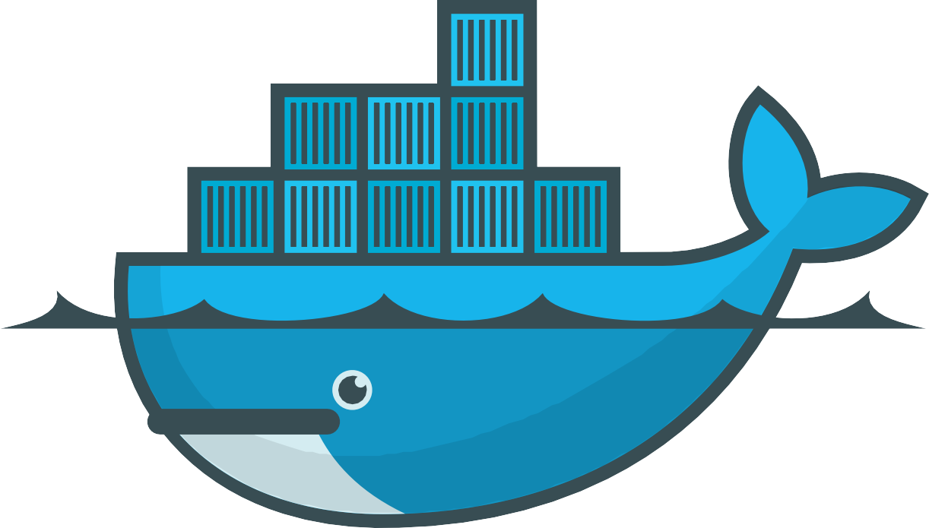
Dockerization
Docker is a software platform that allows you to build, test, and deploy applications quickly.
Docker packages software into standardized units called containers that have everything the software needs to run including libraries, system tools, code, and runtime.
Using Docker, you can quickly deploy and scale applications into any environment and know your code will run.

Slide 9
Steps of Dockerization
To dockerization we need Dockerfile in our application.
After that start docker from docker desktop
Run command mvn install dockerfile:build Check docker desktop weather image is created or not
Push to docker hub from docker desktop.

Slide 10
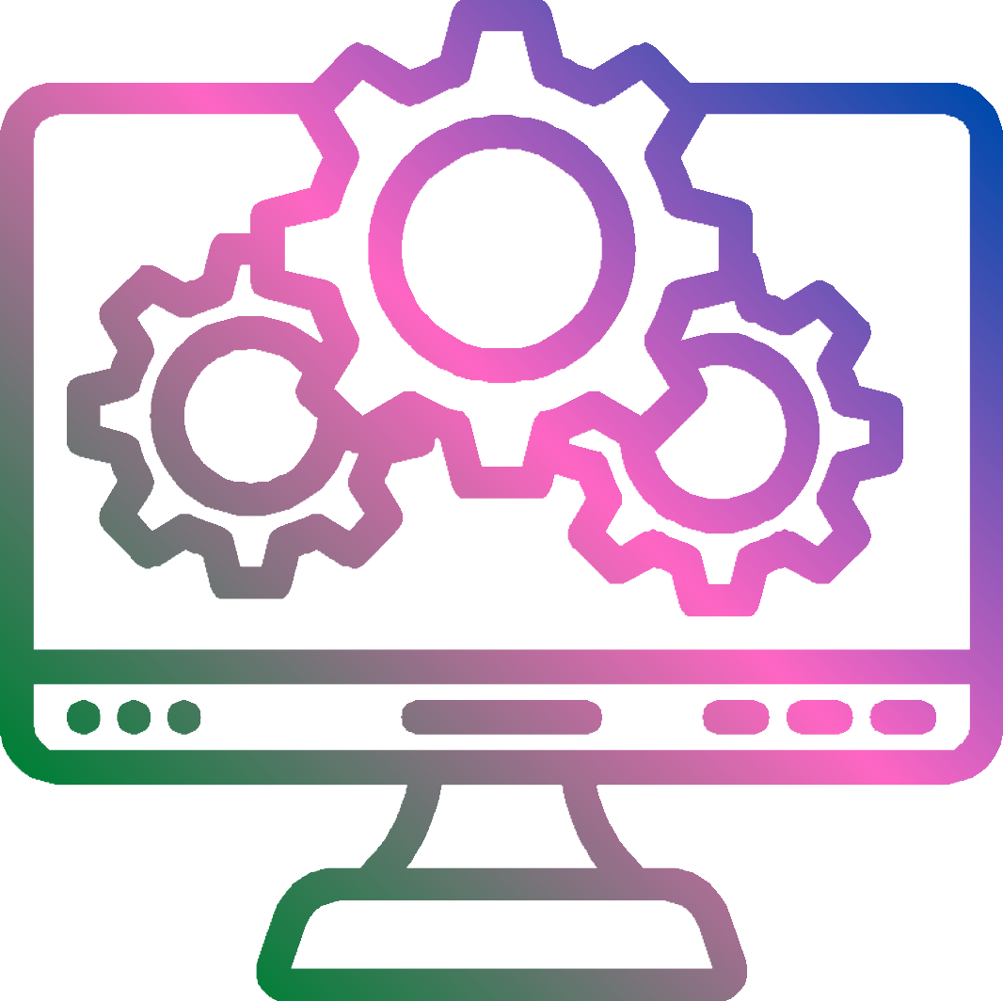

System Requirements
Software Requirements : Java Spring-boot MySQL
Maven Docker
IDE(IntelliJ/Eclipse)
Hardware Requirements :
Windows OS Internet connection

Slide 11
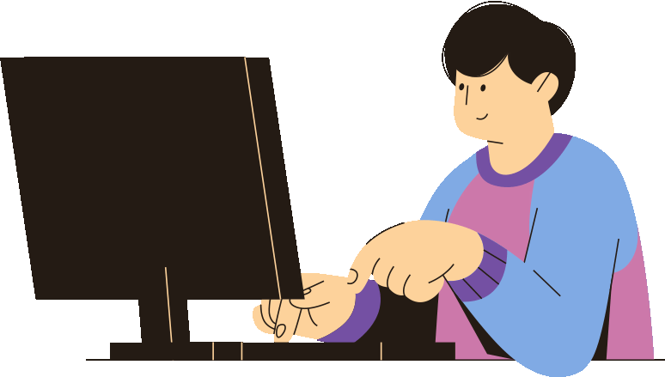
Advantages
It is an User friendly application. MySQL database helps to minimize data redundancy.
User can easily perform operations like add, update, search, delete the data from database.

Slide 12

Conclusion
This Pension Management System is designed to manage pension activities for both applicants and pension admins. It is goot for organization as well as employee because it is easy to use. This project is all about the solution that will largely help eliminate the problems associated with the manual process and easy to manage pensions.

Slide 13
